Slide 1

Welcome to FireFlight!
Meet the Team:
Our team is composed of:
  Alyssa Ortiz- Team Lead, Hosting, Frontend
  Payton Watts- Data Querying, Backend
  Andrew Ortega- Web Development, Frontend
  Tyler Chapp- Data Visualization, Backend
Our clients:
  USDA Forest Service researchers
  NAU SICCS researchers
Mentor: Scott LaRocca
The main focus of this project is to predict the reaction of birds to fires in their habitats, as birds are incredibly reflective of the overall health and recovery of an ecosystem.
Notes:
Payton
Time: Less than a minute (<60 seconds)
Current Time: a bit over a minute

Slide 2

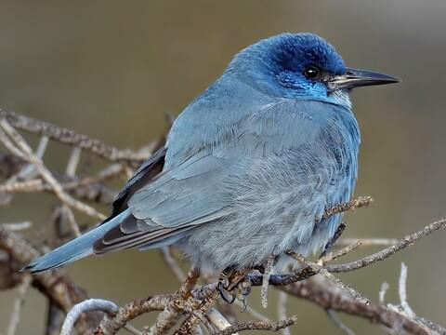
Problem Statement
Clients: Analyze data to determine likelihood of bird presence in an area post-fire
  Birds are an indicator species of an ecosystems health
  Valuable data for Western United States Forestry Management Stations
Clients currently produce and distribute all data + analysis manually
Need a user friendly tool to easily view and export the data on bird presence in an area
Notes:
Alyssa slow down!!!!
Time: ~2 minutes (around 120 seconds) (current time is around 1min & 20-30sec)
Our clients analyze reported data on bird sightings in an area to determine the likelihood of bird presence in a given area
What this means is for example, at a certain spot, there could be a 30% chance that crows will be present.
This is important because birds are an indicator species that reflect an ecosystem’s health.
To determine which course of actions are best to take when maintaining an area, scientists need to first look at how bird populations change in response to natural disasters, especially wildfires.
This data analysis is used by Western United States Forestry Management Stations to help them determine how to properly take care of an area.
Currently, all stations must go through a single point to receive user-friendly analysis for over 10 years of collected data- our clients
They are producing and distributing all of this information manually each time a station requests data.
They need a a user friendly tool that they, and all of the research stations, can use to easily view and export the data on bird presence in an area
Each research station should be able to view and export the collected data on their own, and be able to understand the results in order to increase individual efficiency and free up our clients to work on other important projects, rather than dedicating lots of time to relaying information back and forth

Slide 3
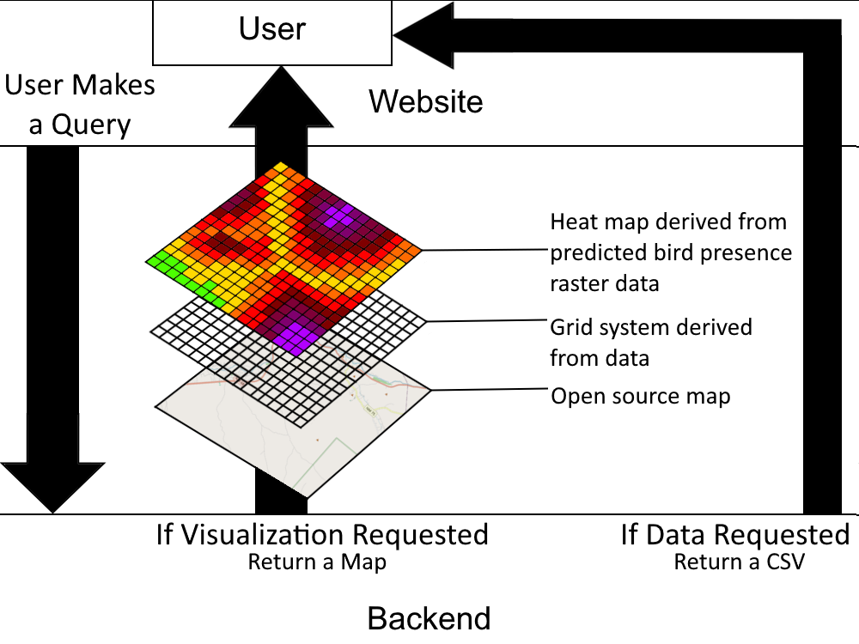
Solution Overview-
What we’re building is a web app that allows users to query a database for bird presence prediction data, receiving it either as a CSV file, heat map, or both.
Notes:
Payton
Time: ~30-45 seconds (current time is around 3 minutes!! for this slide and the next combined)

Slide 4
Solution Overview- Cont.
Key features:
  Ease of access- users need an easy way to retrieve data/maps.
  Easy querying- users should be able to filter the data by species, region, etc.
  Clear visualization- heat maps and data files must be able to clearly visualize what the user wishes to show to forest managers and other officials.
  Security- due to being proprietary USDA information, the database must be safe and protected from cyber threats.
  Built for Future Maintenance- Our code must be readable, instructions for usage clear, and codebase easily maintainable.
Notes:
Given that we will be handing off this project to a government agency for possibly long-term use…
Payton
Time: ~1:15 to 1:30 (current time is around 3 minutes!! for this slide and the previous combined)

Slide 5

Key Requirements
User-Friendly Interface
Data Querying & Filtering
Data Visualization
Exportable Results
Notes:
From working closely with our clients, we gathered 4 key requirements:
User interface that is easy to use for non-technical users
Users should be able to filter and query data such as by species
Bird & wildfire data needs to be transformed into a heatmap overlay then embedded in web-based map
Users need the ability to download filtered data as CSV for further analysis
Tyler
Current Time: ~35 seconds

Slide 6
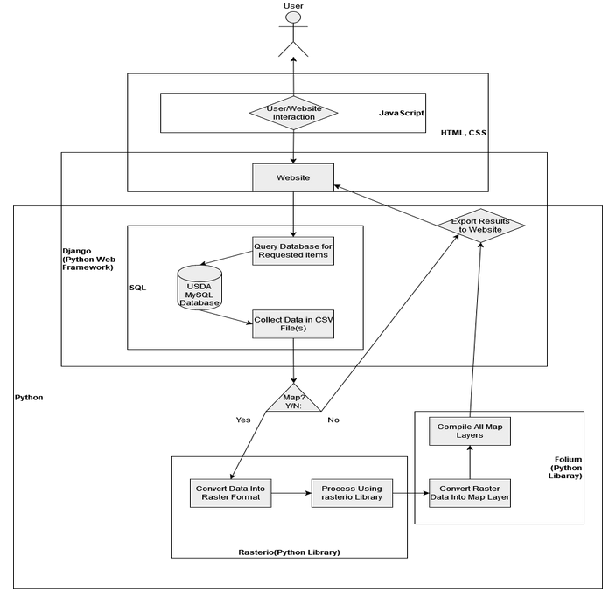
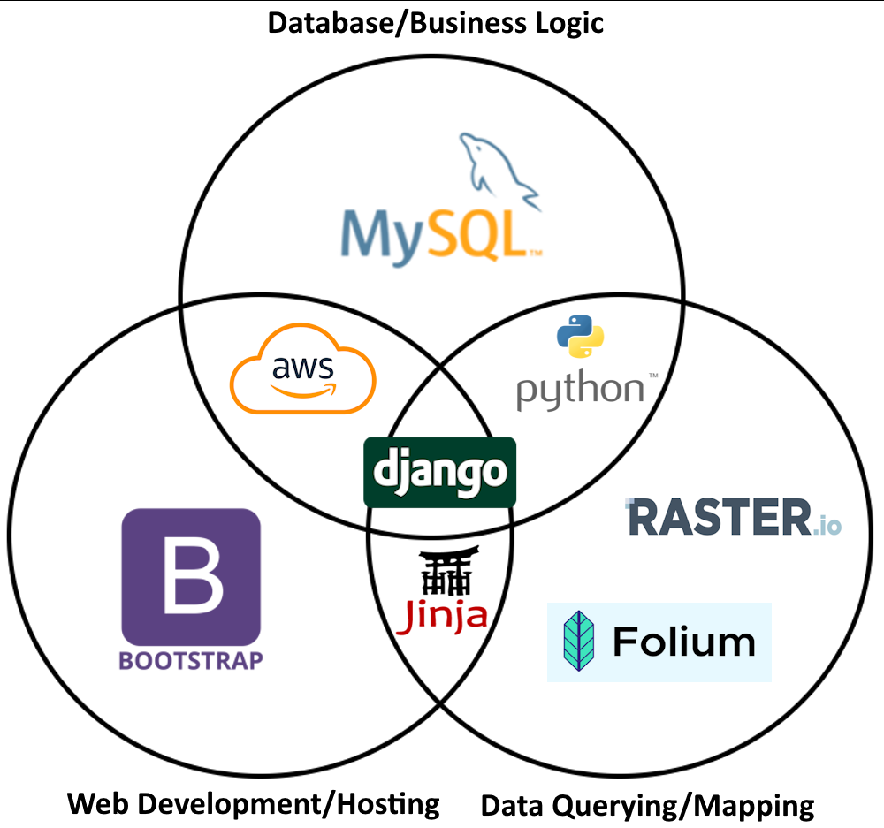
Architecture & Implementation Review
User Interface
Application Logic Module
Mapping & Visualization Module
Database Layer
Notes:
To meet these requirements, we built our system with the following 4 modules:
User Interface
Clear instructions and interactive map displays
Dynamic filtering and CSV export
And was built with HTML/CSS/JavaScript and the Bootstrap CSS library
Application Logic module
Manages data ingestion, processing, and query execution
Converts CSV data for database storage
Generates exportable results
And was built with Django and python serving as our back-end
Mapping & Visualization Module
Renders heatmap overlays and embedded maps
Provides dynamic map updates to front-end
We used raster.io and folium to build this module
Database Layer
Store data in SQL database
Return queried information
MySQL database managed by Django
Tyler
Current Time: ~45 seconds

Slide 7
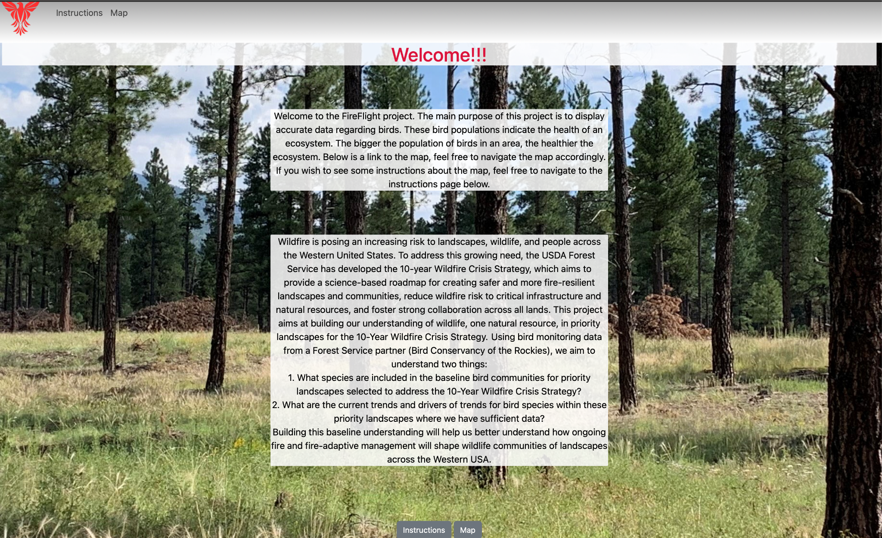
Intro
Notes:
Andy
Spend like 10 seconds tops
Use language to emphasize the product is basically done
Current Time: 45 seconds

Slide 8
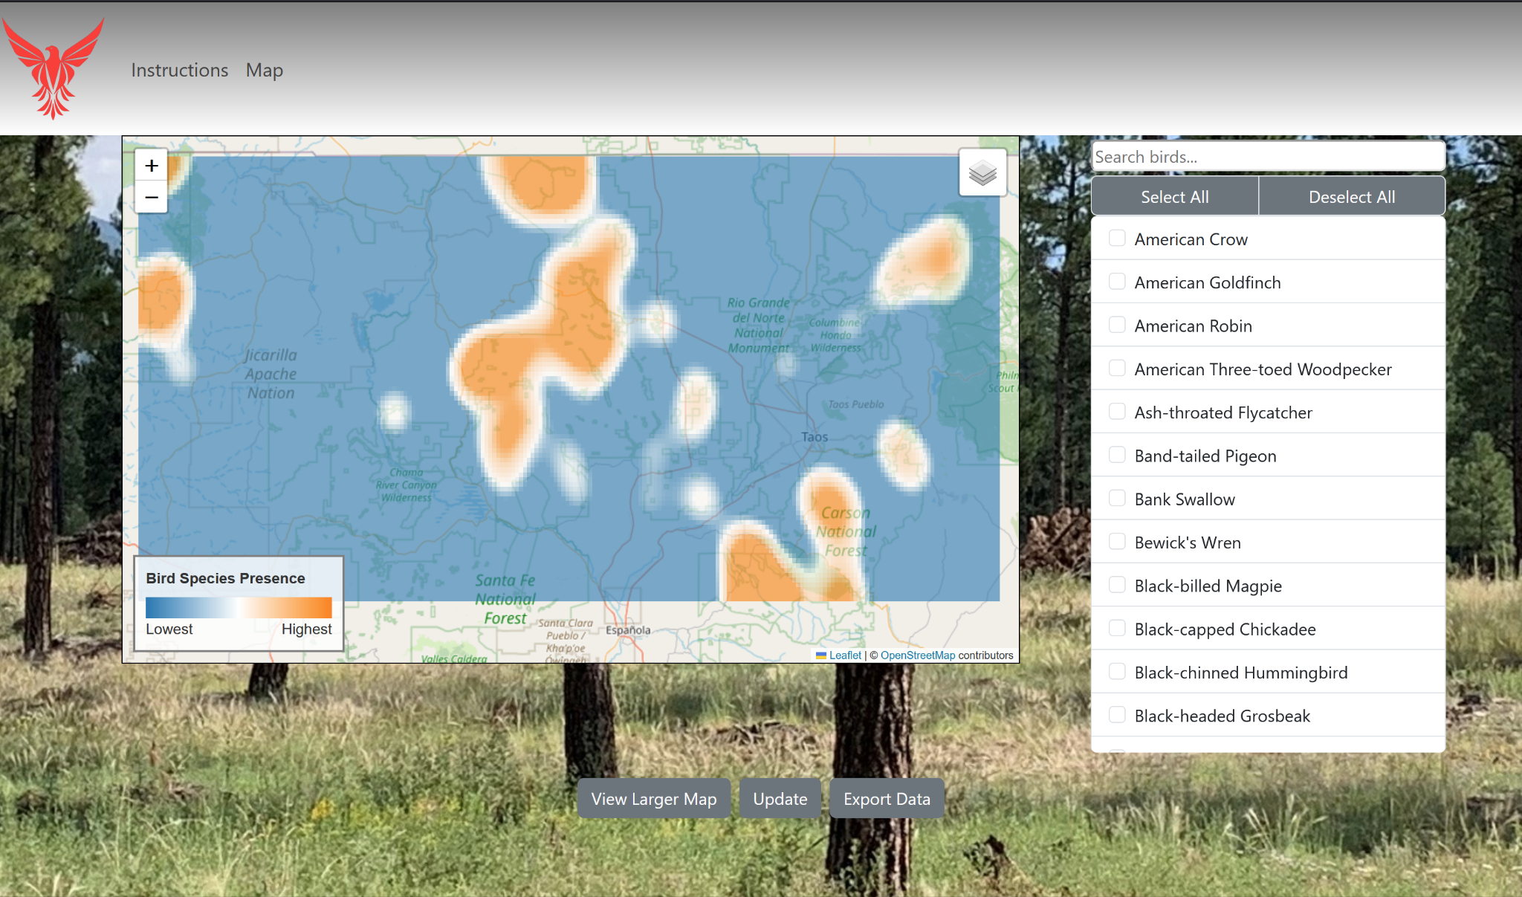
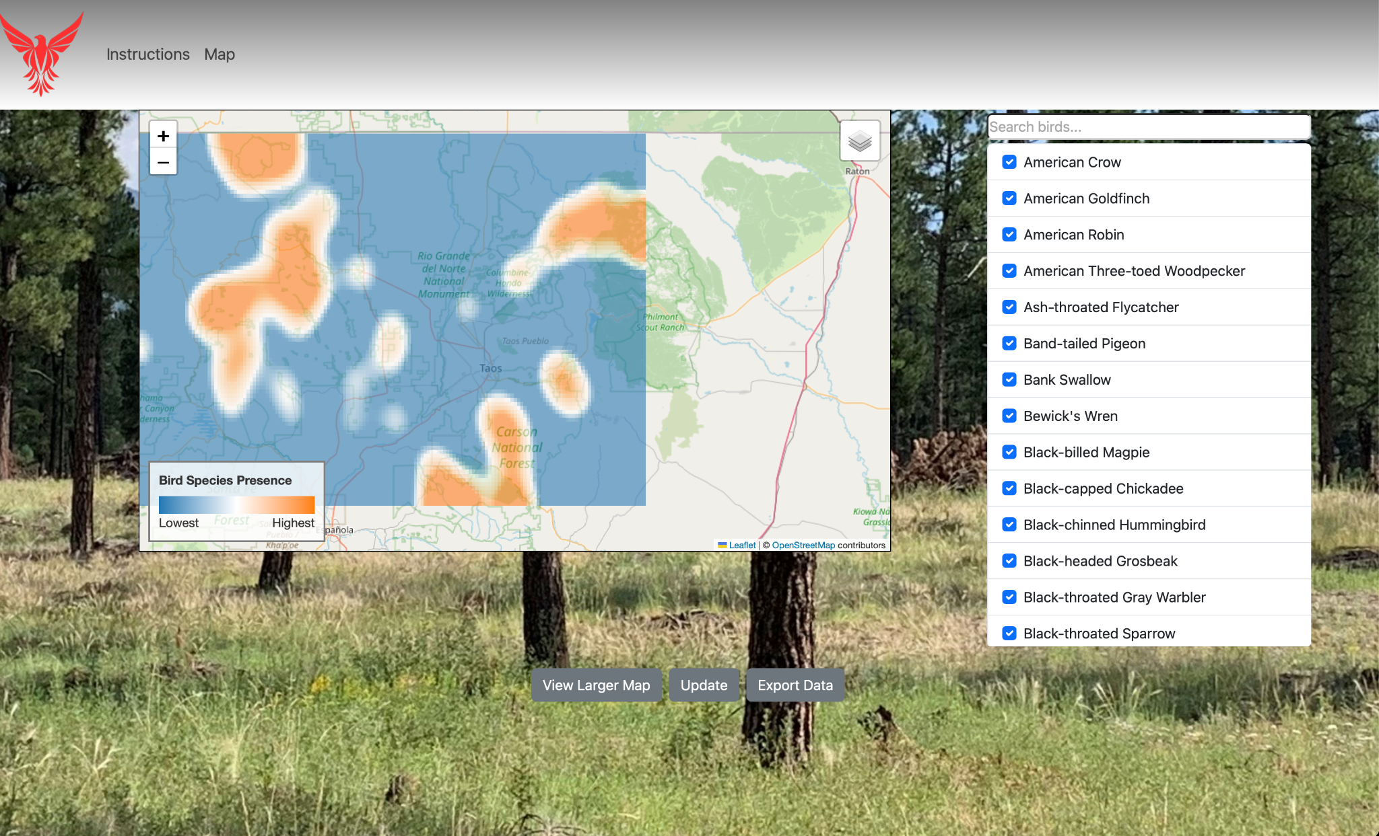
Map
Notes:
Andy, then transition to Alyssa
Andy Current Time: 17 sec
Alyssa Current Time: 30 seconds
On the right is a list of all bird species that have data available. Once the chosen species are selected, you can click the update button to regenerate the map and export csv file.

Slide 9
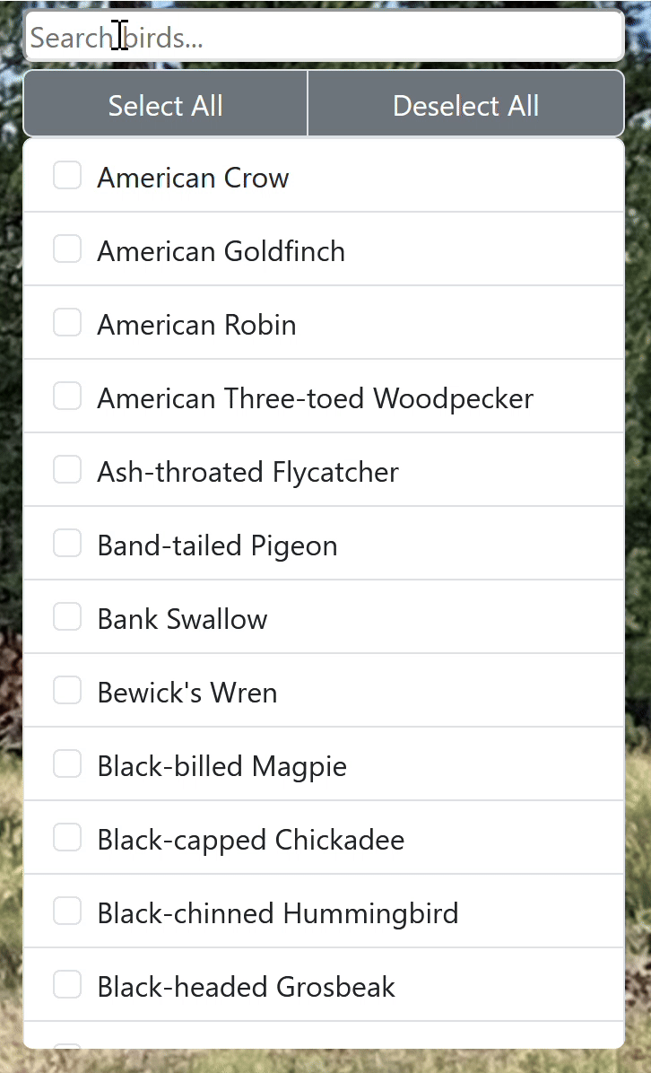
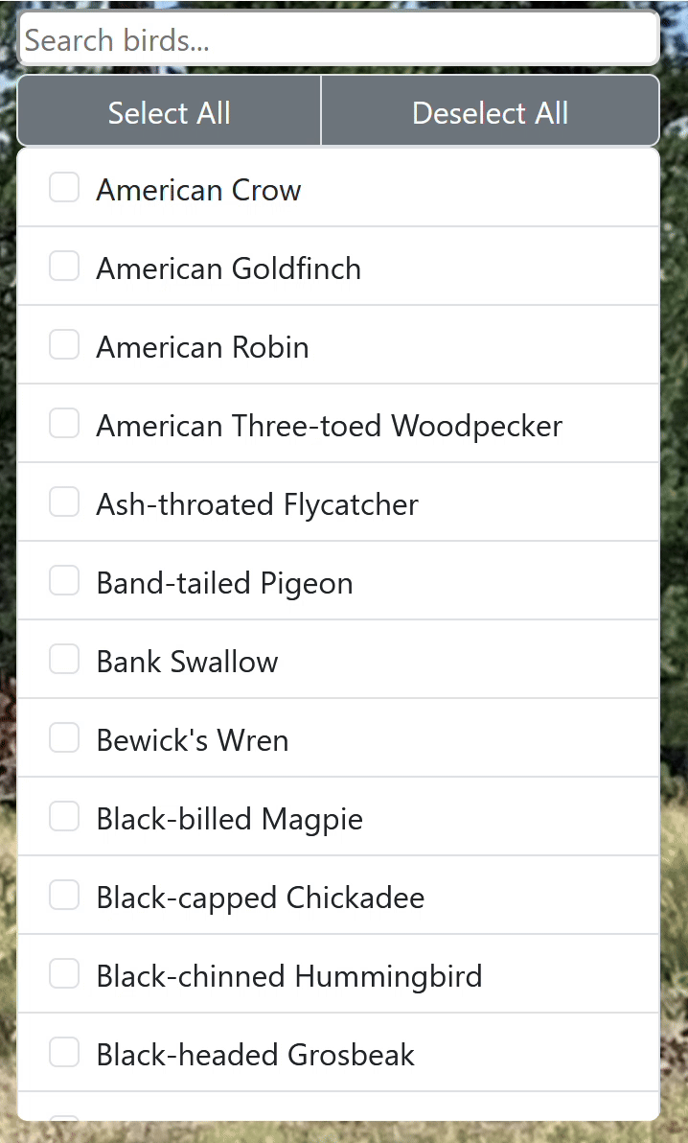
Live Search
Select/Deselect All
Notes:
Alyssa
Should only spend MAX 20 seconds
Current Time: 30 seconds
Here, you can see our live search feature, as well as our select and deselect all options. This is essential as there are currently about 100 different bird species in the list.

Slide 10
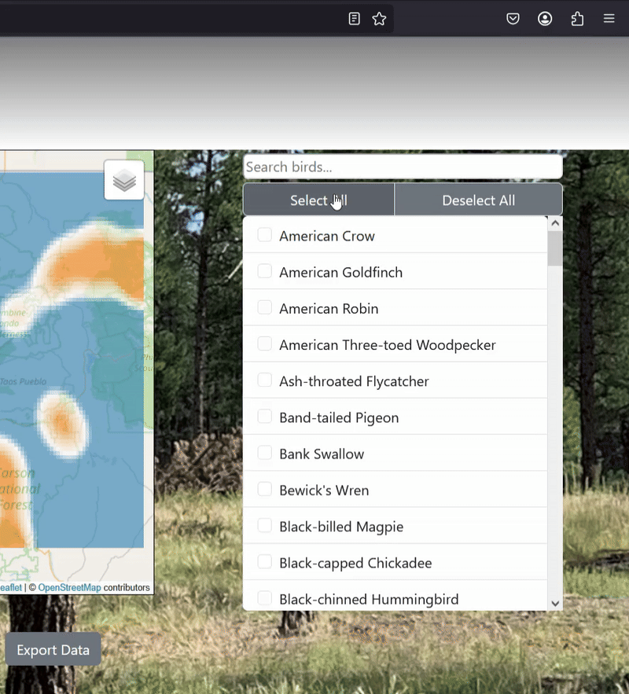
Clicking the export button
Notes:
Payton
When a CSV of the database is requested via a button click, a querying view goes through the database and writes a CSV file containing elements such as the birds selected, their presence, and the specific grid being searched.
The view then promptly triggers a downloads of this output file through the users browser.

Slide 11
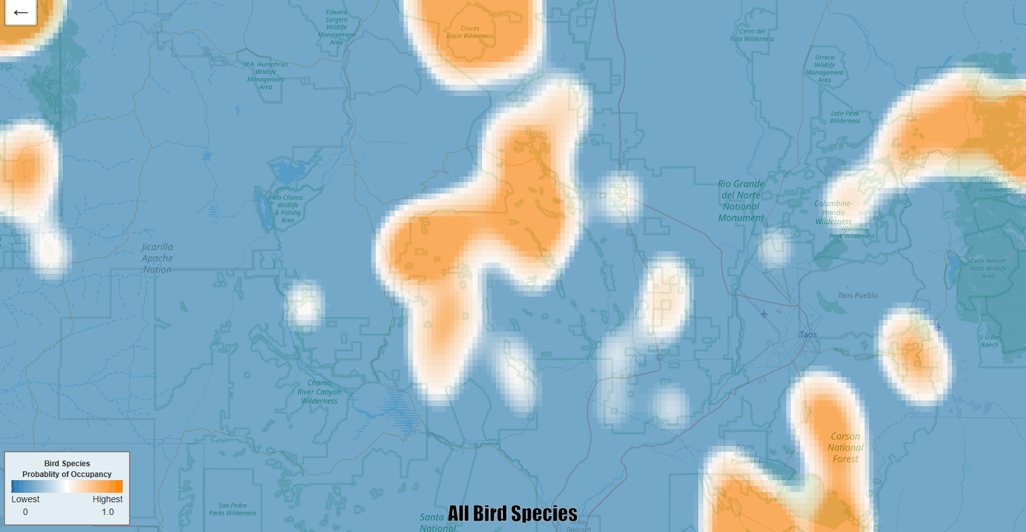
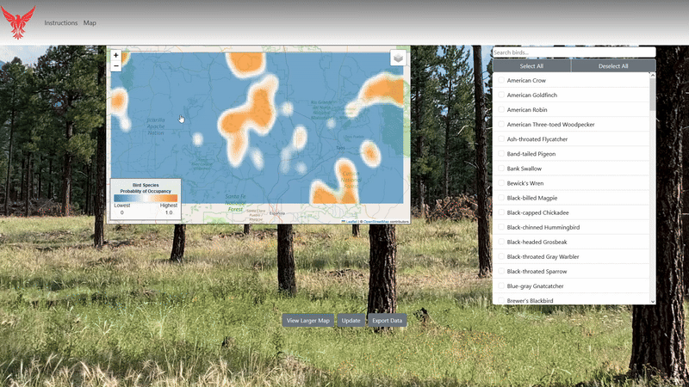
Map Generation
Map Navigation
Notes:
Now we will take a closer look at our map generation and visualization module:
On initial load of the map page, data is received from the database to generate a visual based on all species data
Otherwise, the visual is generated based on the output CSV file containing filtered data
Uses Raster.io to convert raw data into raster format
Folium to create interactive web maps that allow easy navigation
Data is displayed as a heatmap to show likelihood of bird presence
Use Gaussian smoothing which transforms data by emphasizing nearby values to help create more meaningful data points
Supports dynamic updates from filters chosen by the user like by species
Tyler
Current Time: 45sec

Slide 12
Populating the Database
Uses a Django custom command
Takes in a CSV file that properly corresponds to one of the three models we use
If there are no issues, the command will write the data into the appropriate table, updating values where necessary
Notes:
Payton
Using a Django custom command we made, users can auto-populate their database, by combining the populate command with a CSV of proper format.
The command parses the file and ensures its contents follows one of the three Django data model standards.
If no errors are present, the file is written into the MySQL database table for that particular model.
Should only spend MAX 20 to 30 seconds
Current Time: 55 sec

Slide 13
Challenges and Resolutions
Regenerating the Map on Reload
  Potential Solution: Using caching to determine when to regenerate the map
Optimized for 1 user at a time
  Potential Solution: using unique session ids when generating maps and processing requests
Seamless transfer to clients
  Potential Solution: Detailed instructions for setup, use, maintenance, and error handling
Notes:
Alyssa Slow down!!!!
Time: ~1 (current time is 54sec)
Currently, we have a few ongoing challenges with our project.
As of now, our map regenerates every time the map page is reloaded.
A Potential Solution is to use caching to determine when to regenerate the map, preferably only when the user clicks the update button.
Currently, the website is only Optimized for 1 user at a time as it can only generate one map at a time.
A Potential Solution is to use unique session ids for each user when generating maps and processing requests
Because of the major restructuring of the US Forestry Department currently happening, it is very likely that our clients will initially have to set up and manage the website by themselves.
Because our clients are not as familiar with web development as we are, we need to create detailed documentation and instructions to ensure that they are able to properly set up, use, maintain, and fix any errors that may show up.

Slide 14
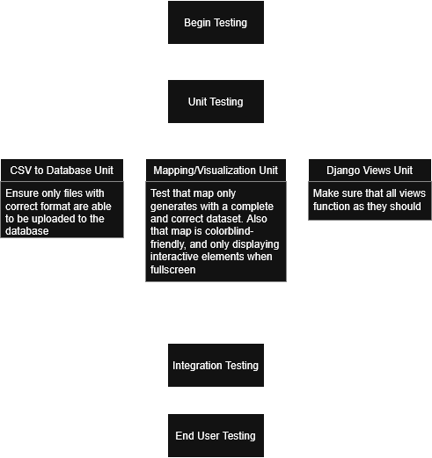
Testing Plan
Notes:
Payton
Time: ~1-2 minutes
Current Time: 3 minutes!!

Slide 15
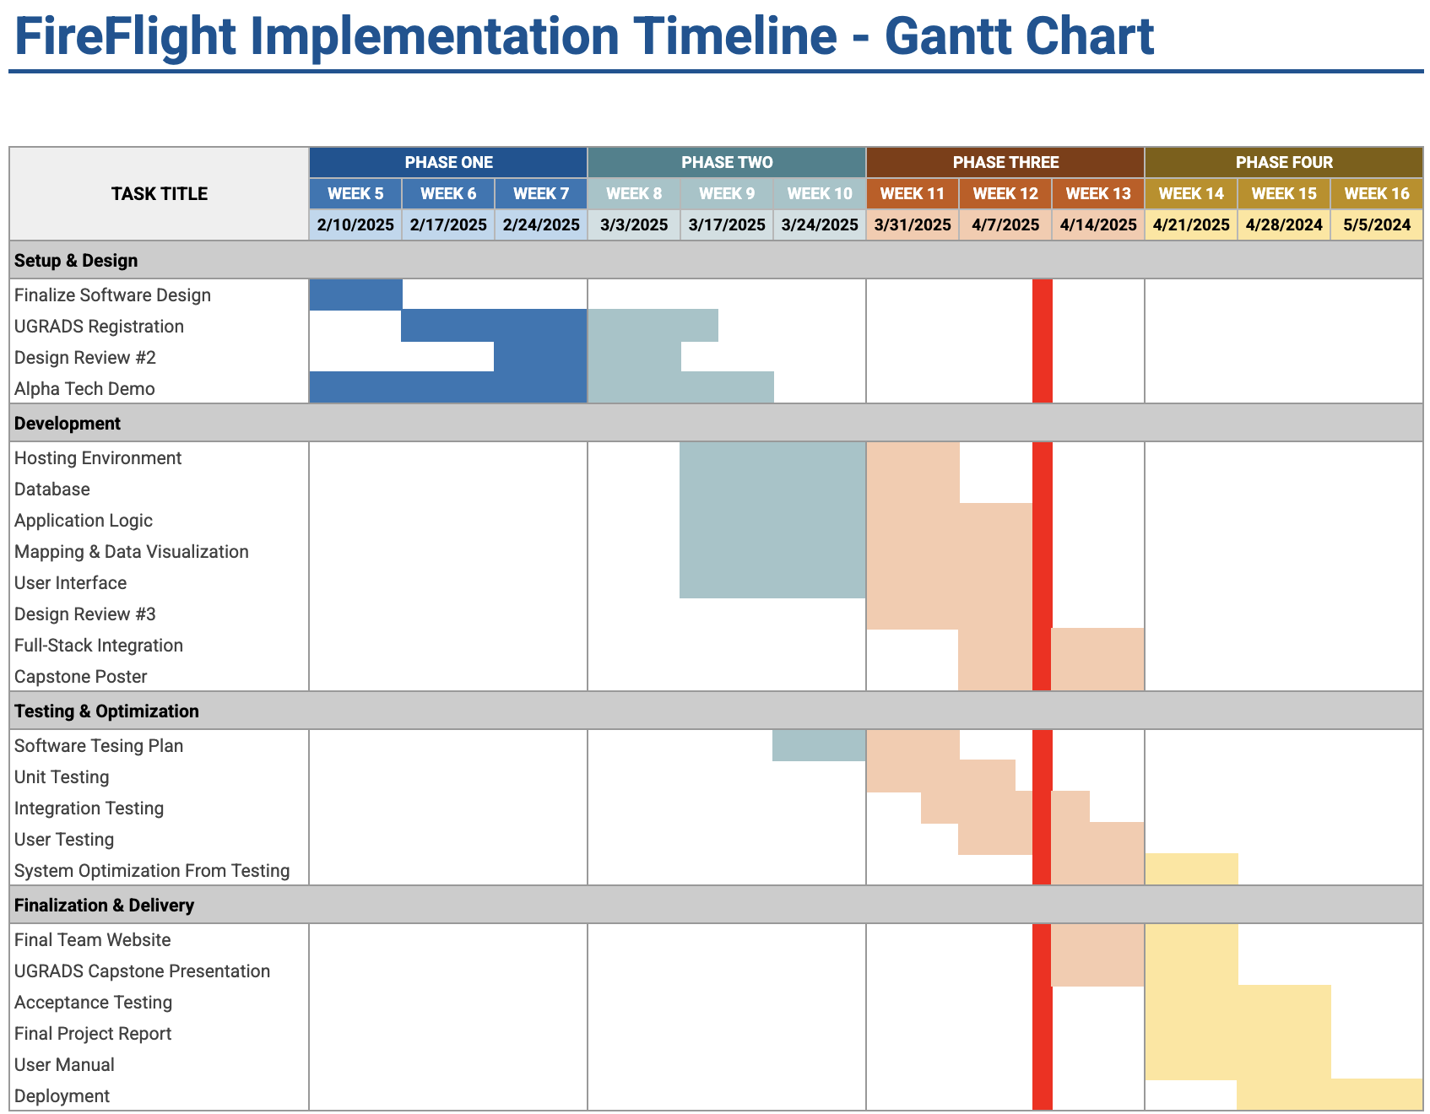
Schedule-
Notes:
Andy
Time: ~ 1 minute (current time is about 53sec)
Say mvp is done
Mention multi-testing

Slide 16
Conclusion
A user friendly tool is needed to easily view and export the data on bird presence in an area after a fire occurs
Our goal is to produce this useful tool
With testing focused on Unit Testing, Integration Testing, and User Testing we want to ensure that our tool works with our clients requests
Despite some challenges that we face, we are on track to deliver a useful product for our clients
Notes:
Andy
Use language to emphasize the product is basically done
Time: less than a minute (<60) (current time is about sec)

Slide 17
Any Questions?
Notes:
Alyssa
Thank you all for listening. Does anyone have any questions?

